Slide 1
Flight Delay Analysis, and prediction along with route scaling using Hadoop PySpark
Megh Raj Upreti
Mohammed Zoher Guniem
9th March 2020
DAT 500 – University of Stavanger
Notes:
Megh and Mohammed
1

Slide 2
Use case
Statistics
Constructing basic statistics like sum and average of delays based on route, origin, destination, and time.
Scaling and clustering for air traffic simulation
With the help of Hadoop, we aim to make our dataset easily scalable, and accessible for air traffic simulation.
Prediction of flight delays
Delay prediction model stored on Hadoop file system, with best possible accuracy.
Notes:
Mohammed
We will open our project by using PySpark to process our dataset and construct some basic statistics like the sum, average, median, mode of delays different delays based on route, origin, destination, aircraft and time.
Multiple simulation software is used to train new pilots and in air crash investigations are depended on having a dataset that is easily scalable and accessible.
We are going to try building a prediction model that can be stored on the Hadoop File System.
This model should allow a user to predict flight delays, hopefully with a good accuracy.
2

Slide 3
Introduction
A flight delay is said to occur when a commercial aircraft lands or takes off later than its scheduled arrival or departure time respectively.
Usually > 15 minutes is considered as flight delay.
Every year, 23% of the flights are delayed or cancelled, costing 8 billion dollars to airlines, and 20 billion dollars to travellers in lost time and money.
More delay in the aviation industry can result in higher fuel expenses, operating costs, and maintenance issues.
Notes:
Megh
3

Slide 4
Research problem
Primary Research question
- Will a scheduled domestic flight in the united states take off and arrive at its destination airport with or without delay? And who long might any delay last?
Secondary research questions
Which state, city and airport is the busiest or least busy among all origins and destinations?
Which carrier suffers most delays and least delayed carrier?
When is the best day of week/time to travel to minimize delays?
Is it possible to make our dataset more scalable and easy to filter for use in simulation software?
Notes:
Mohammed
4

Slide 5
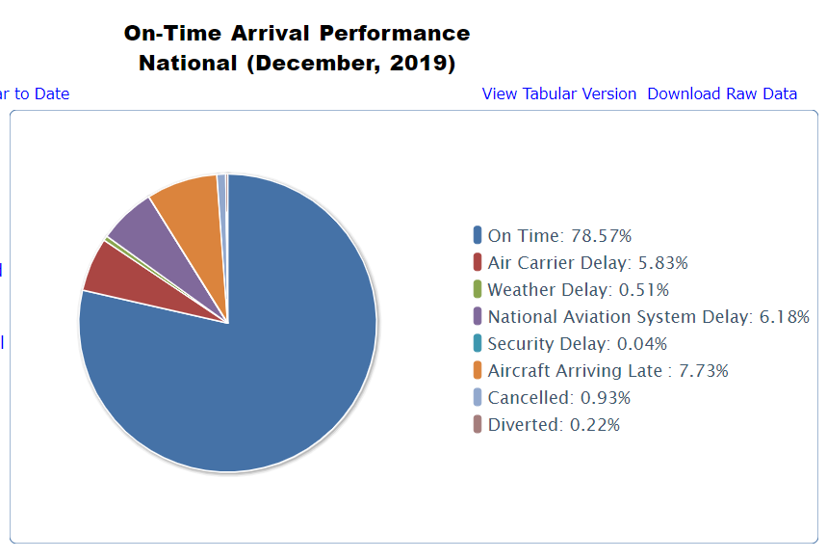
Types of Delays
https://www.transtats.bts.gov/OT_Delay/OT_DelayCause1.asp
Notes:
Megh
5

Slide 6
Dataset
Datasets from: Bureau of Transportation Statistics (Domestic flights for USA).
1.5 GB data consisting of flights of 2019 for all months(But more data is available from 1987).
Attributes: We plan on using most of the following 34 variables.
Notes:
Megh
6

Slide 7
Data variables
YEAR, MONTH, DAY_OF_MONTH, DAY_OF_WEEK,
OP_UNIQUE_CARRIER, TAIL_NUM, OP_CARRIER_FL_NUM,
ORIGIN, ORIGIN_CITY_NAME, ORIGIN_STATE_NM, DEST, DEST_CITY_NAME, DEST_STATE_NM,
CRS_DEP_TIME, DEP_TIME, DEP_DELAY, TAXI_OUT, WHEELS_OFF, WHEELS_ON, TAXI_IN, CRS_ARR_TIME, ARR_TIME, ARR_DELAY, CANCELLED, CANCELLATION_CODE, DIVERTED, CRS_ELAPSED_TIME, ACTUAL_ELAPSED_TIME, AIR_TIME, DISTANCE,
CARRIER_DELAY, WEATHER_DELAY, NAS_DELAY, SECURITY_DELAY, LATE_AIRCRAFT_DELAY
Notes:
Mohammed
7

Slide 8
Related Works:
• ”Predicting Flight Delays” in 2012 (Lawson & Castillo), used flights datasets but included several years, which resulted in an impressive number of data points (135 million of flights) with weather data only. Used SVM, random forests, and naïve Bayes. All three methods performed about equivalently, but with error rates that were not clearly much better than a trivial predictor
”Predicting airline delays” in 2012 (Bandyopadhyay & Guerrero, 2012), focused only on one airport(Chicago) and one airline company(AA)for 2007-08, with weather data only. Even though they were able to achieve a good score, their model is restricted to 80000 records and may not generalize well to other airlines and airports. Used SVM, Naïve Bayes and Logistic regression
Notes:
Megh
8

Slide 9
Tools and algorithms which we plan on using
Statistics:
Power BI reactive model
- Pyspark framework or Hadoop MRJob
Prediction:
- Decision Trees
- Random Forest
- XGBoost
- Pyspark framework or Hadoop MRJob
Scaling:
- Pyspark framework or Hadoop MRJob
Notes:
Mohammed
9

Slide 10
References
Bandyopadhyay, R. and Guerrero, R. Predicting airline delays. Technical report, Computer Science Department, CS 229, Stanford University, Stanford, CA, 2012
https://engineering.berkeley.edu/news/2010/11/flight-delays-cost-more-than-just-time/
http://cs229.stanford.edu/proj2016/report/DuperierSauvestreLeaf-ModelingFlightDelays-report.pdf
Lawson, D. and Castillo, W. Predicting flight delays. Technical report, Computer Science Department, CS 229, Stanford University, Stanford, CA, 2012
OST_R | BTS | Transtats. (2020). Retrieved 1 March 2020, from https://www.transtats.bts.gov/Fields.asp?Table_ID=236
Notes:
Megh and Mohammed
10

